Slide 1
Case Study: AirBnB Price Prediction
Submitted By: Rudri Jani

Slide 2
Data Collection
The data is collected from the Inside AirBnB website.
Link: http://insideairbnb.com/get-the-data/
The data file listings.csv is stored on the google drive and code run with google colab by mounting the drive.

Slide 3
Data Analysis

Slide 4
Exploratory Data Analysis (EDA)
There are total 18 columns with 8056 rows.
Following features have numerical data type like int64 or float64
‘id’, ‘host_id’, 'latitude', 'longitude', 'price', 'minimum_nights', 'number_of_reviews', 'reviews_per_month', 'calculated_host_listings_count', 'availability_365', 'number_of_reviews_ltm'
The following features have object data type
columns host_name, name, neighbourhood, room_type, last_review, license
Missing values in data
neighbourhood_group column has all (100%) missing values
host_name has 1 missing value
last_review and reviews_per_month has 23.386% missing values
license column has 36.8% missing values.

Slide 5
The room_type has 4 different categories with its count:
Entire home/apt (4982)
Private room (2948)
Shared room (68)
Hotel room (58)
The name column depicts the features of the property like,
Type of property like home or rental unit
Ratings
Number of bedrooms
Number of beds
Number of bathrooms
The data describes following frequent feature values
hotels in San Francisco.
host is Allen,
neighbourhood is Downtown/Civic Center,
room type is home/apartment.

Slide 6
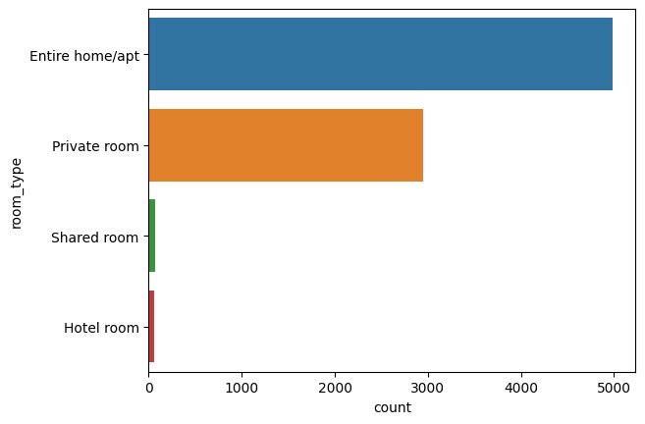
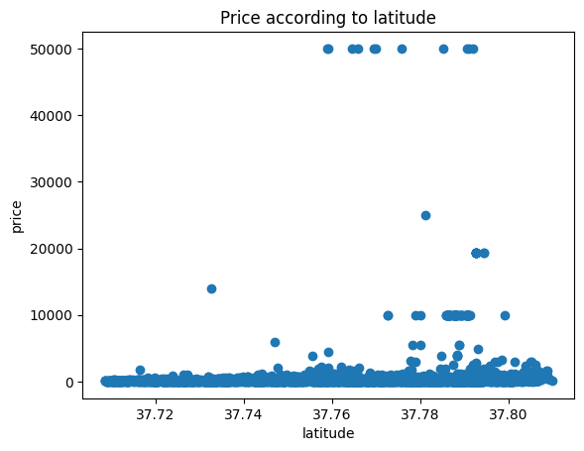
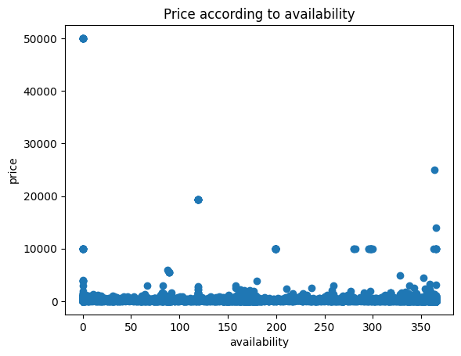
Data Visualization
room_type count distribution
price v/s latitude
price v/s availability

Slide 7
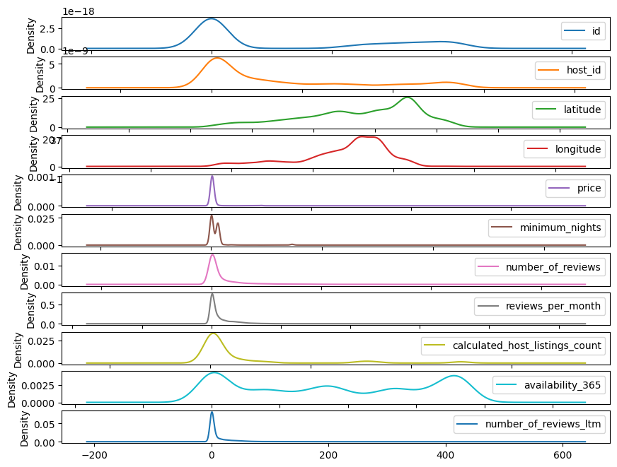
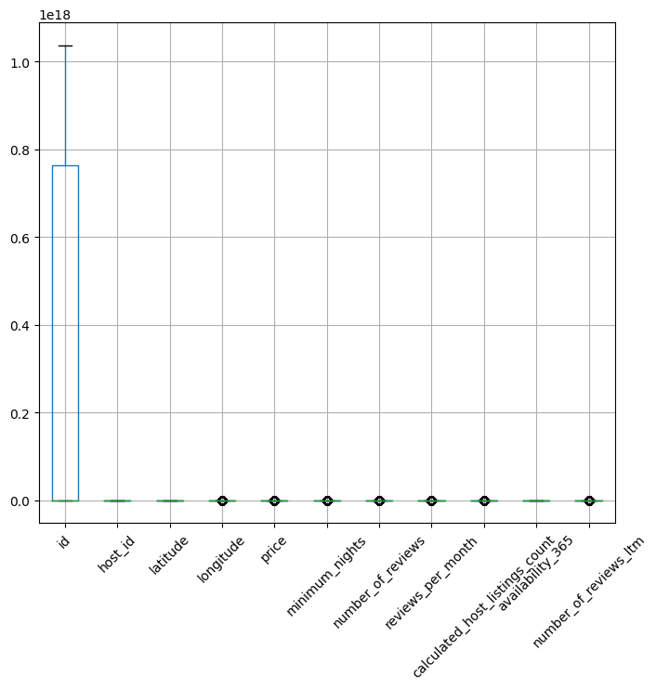
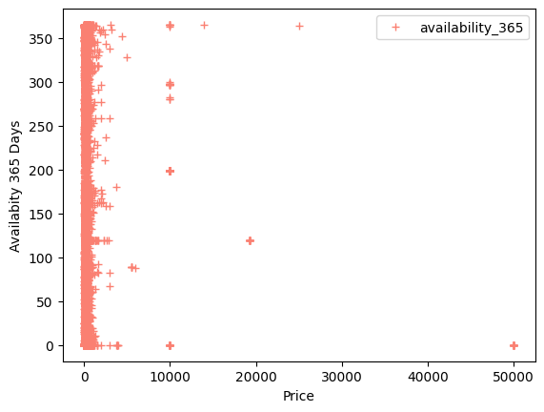
365 days availability
v/s
price
density distribution of each feature
boxplot of the features

Slide 8
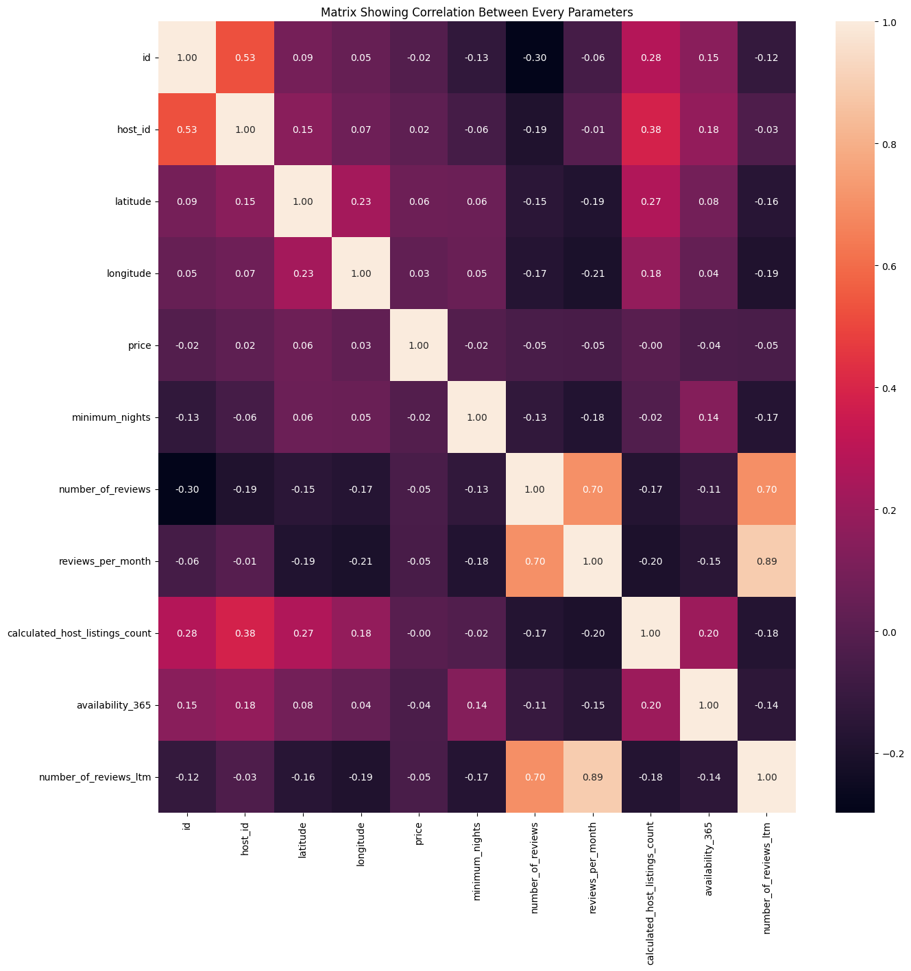
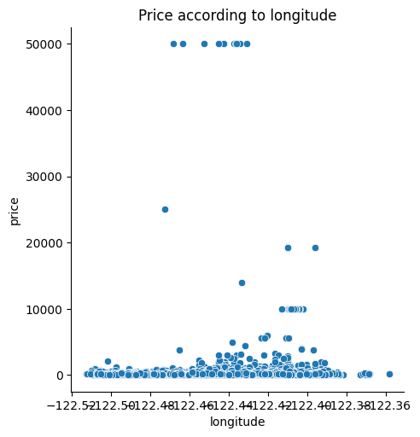
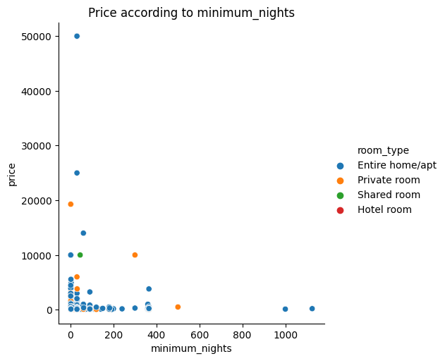
Data Visualization
Price v/s longitude
Price v/s minimum_nights alongwith room_type
From the correlation map, it is seen that there is no strong correlation of any feature with price.

Slide 9
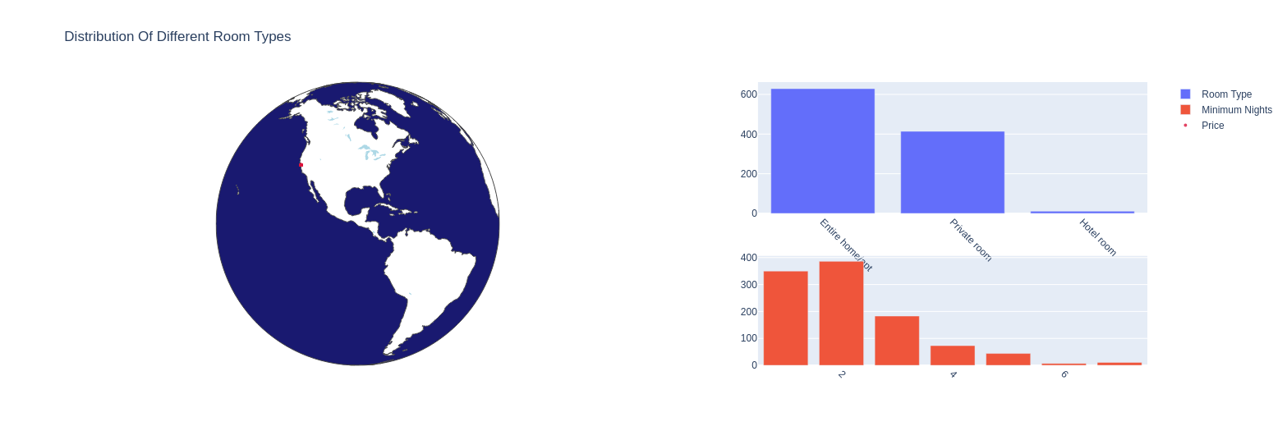
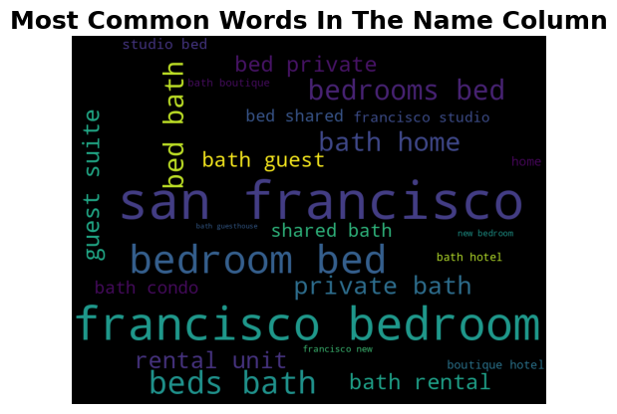
Data Visualization
From the word cloud of names, it can be understood that this column describes the room facility itself. The words that contribute to the price of the room.

Slide 10
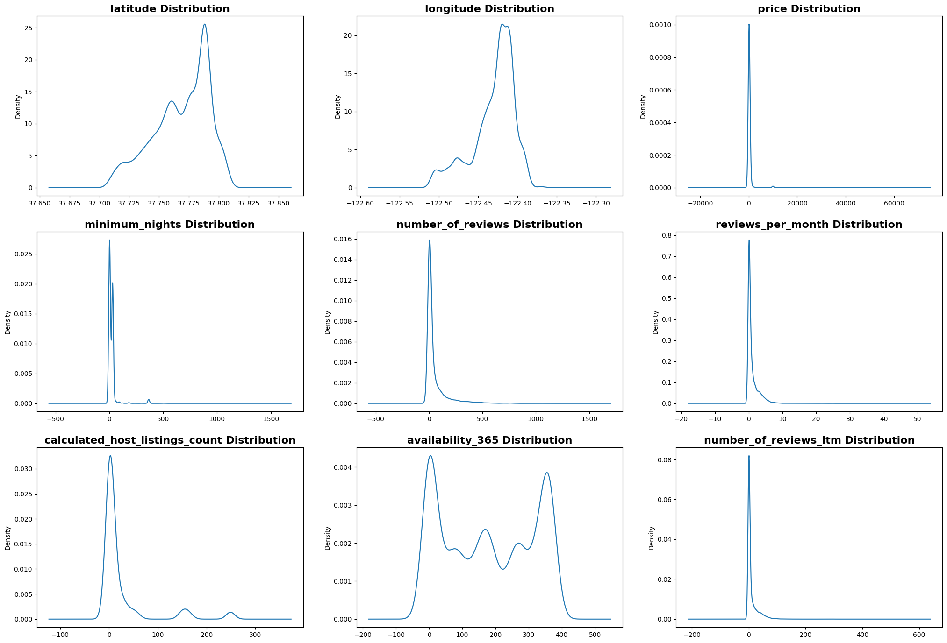
Data distribution before outlier removal

Slide 11
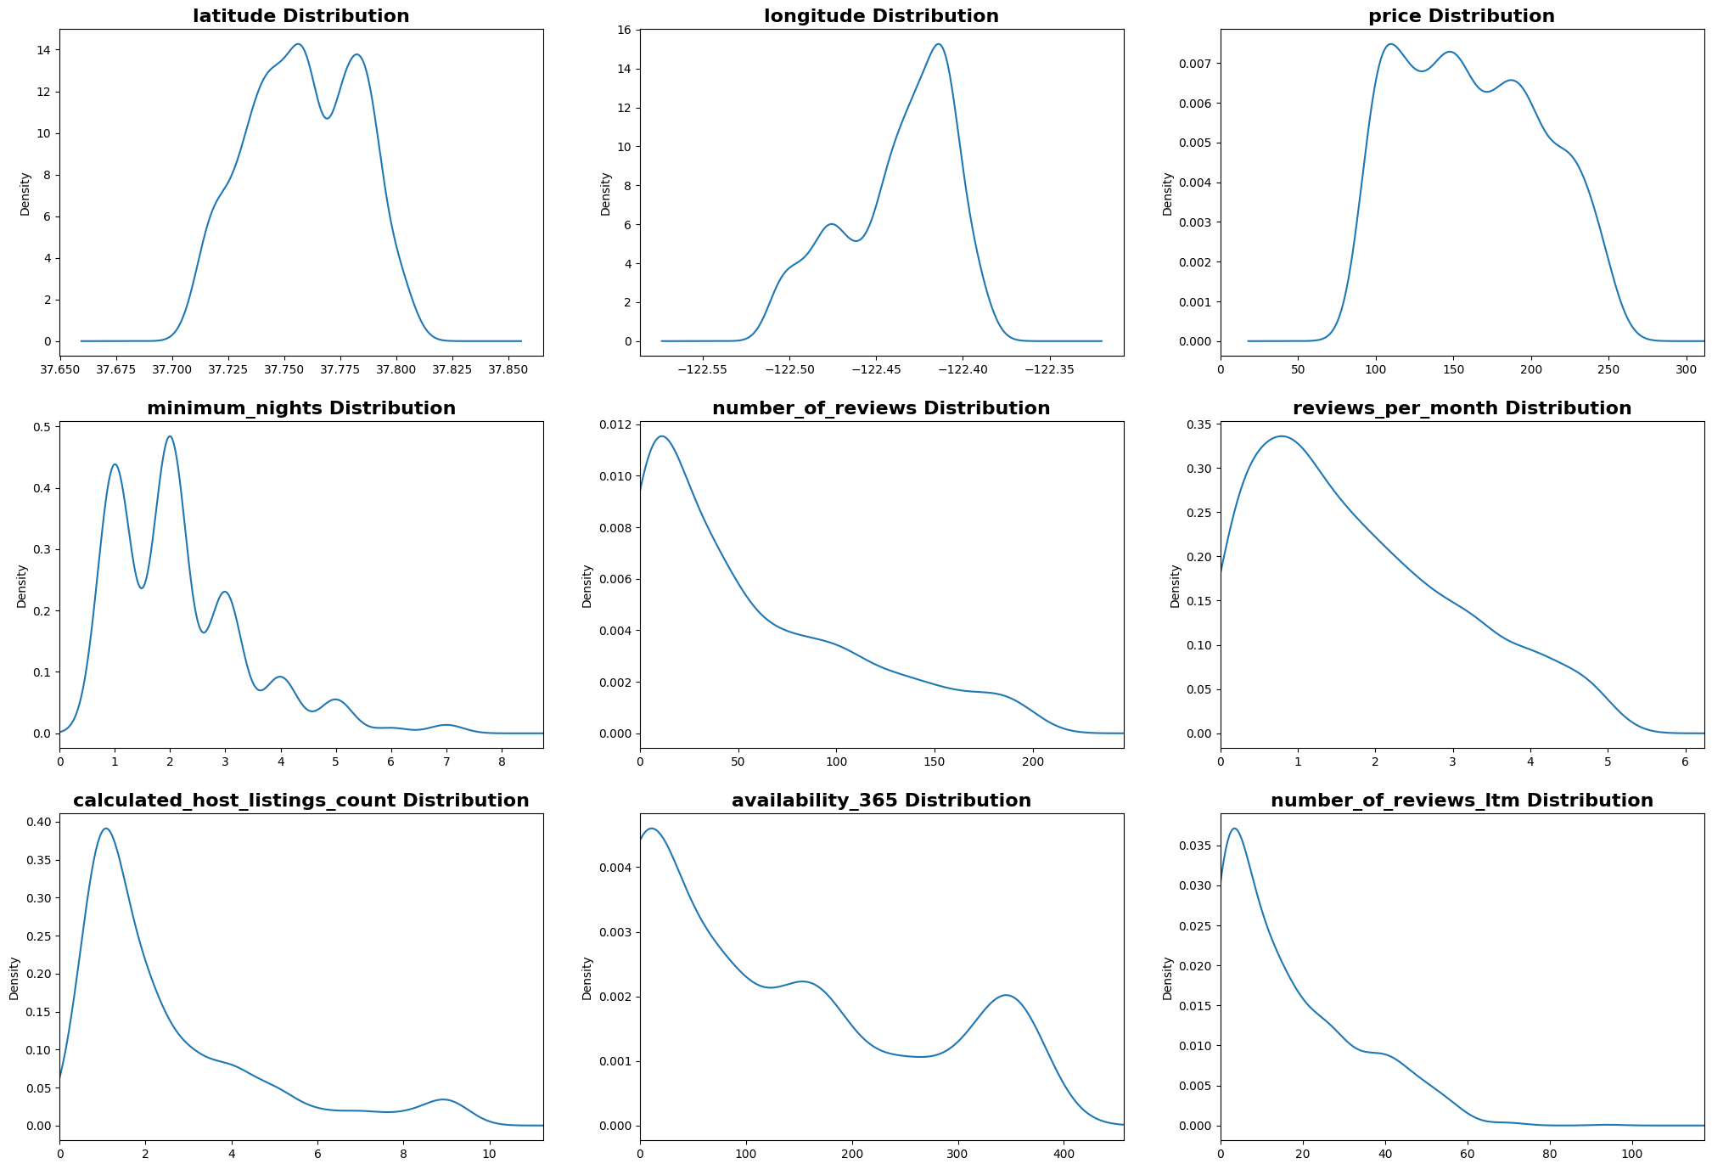
Data distribution before outlier removal
After outliers are removed, it is seen that number_of_reviews,review_per_month, calculated_host_listings_count and number_of_reviews_ltm follows exponential distribution.

Slide 12
Data Preprocessing
The neighbourhood_group column is dropped as it has all null values.
The columns with missing values are filled with values.
host_name and license: None
reviews_per_month and last_review: 0
The outliers are removed according to the interquartile range. After that the final data size is 1054 rows and 11 features.
The neighbourhood, room_type and license columns are encoded with LabelEncoder functionality of sklearn library.
After encoding, from the correlation values, it is seen that no features are highly correlated with price.

Slide 13
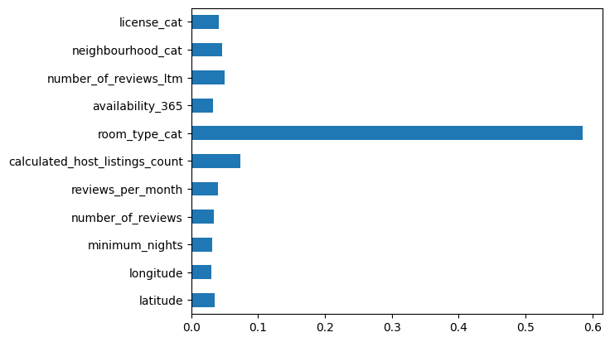
Feature Importance
XGBoost regressor is applied to obtain the important features using ensemble learning.
From the given graph, it is seen that room_type has the maximum contribution in predicting the price.

Slide 14
Model Building

Slide 15
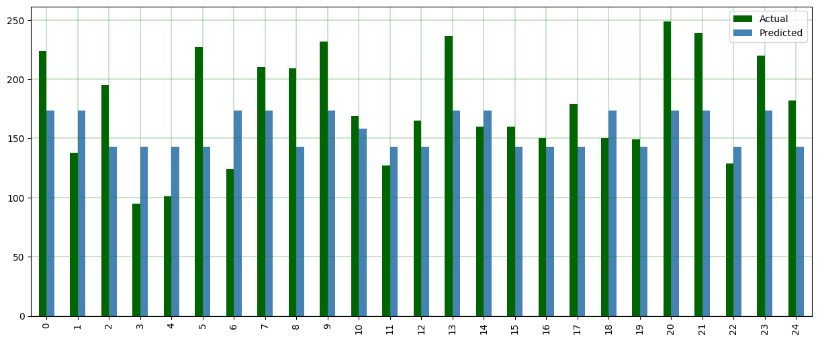
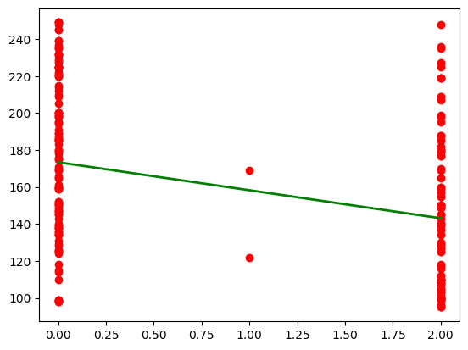
Linear Regression
A linear regression model describes the relationship between a dependent variable, price, and one or more independent variables, room_type.
Visualization of first 25 actual v/s predicted values

Slide 16
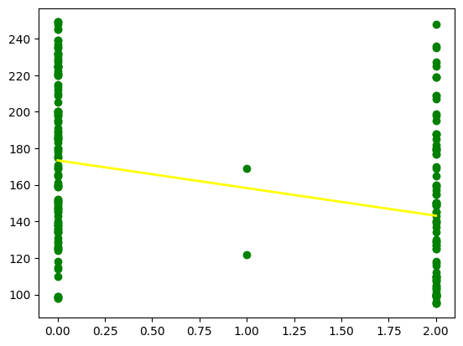
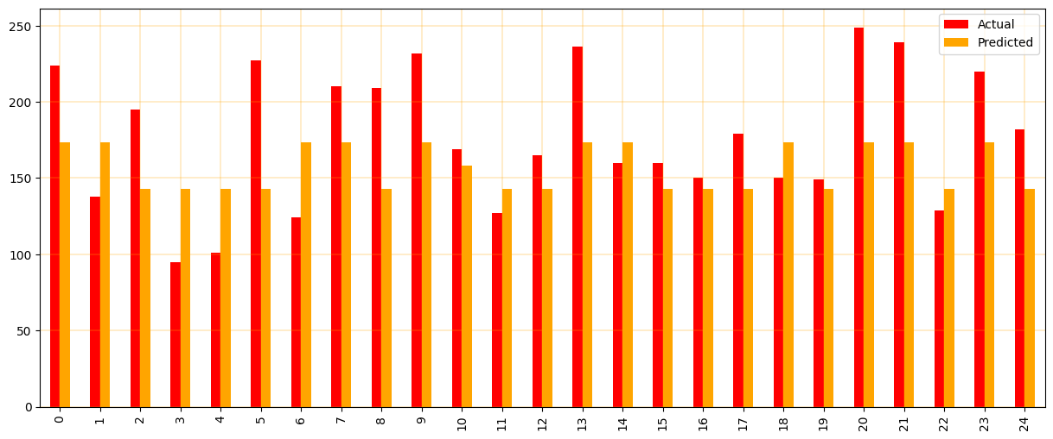
Ridge Regression
It is used to analyze the data that suffers from multicollinearity.
Visualization of first 25 actual v/s predicted values

Slide 17
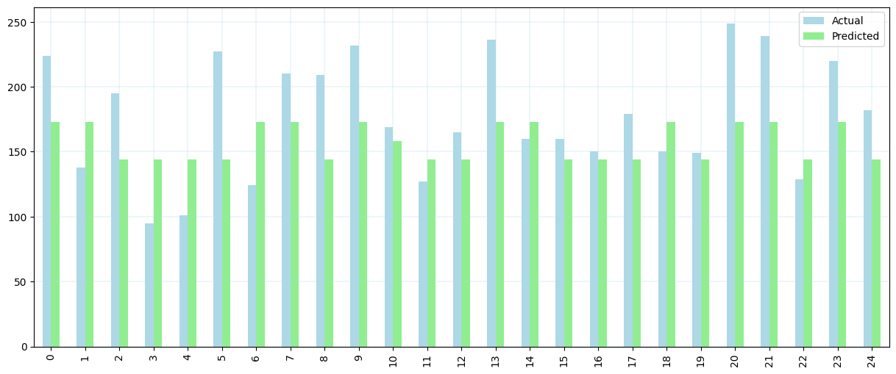
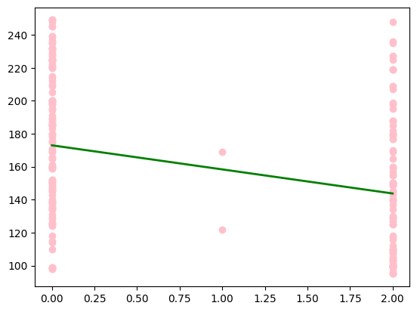
Lasso Regression
It performs both variable selection and regularization in order to enhance the prediction accuracy and interpretability of the resulting statistical model.
Visualization of first 25 actual v/s predicted values

Slide 18
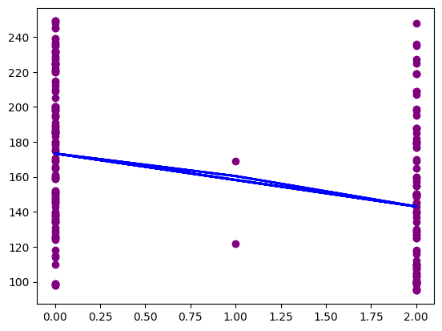
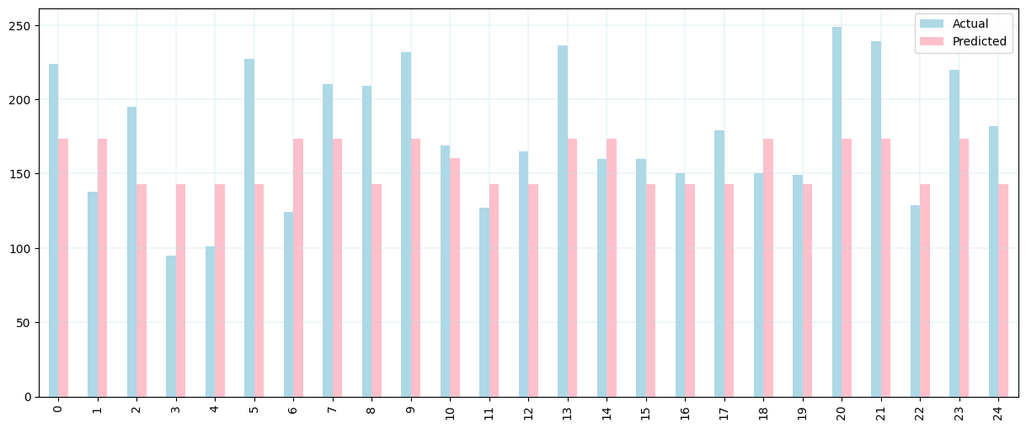
Regression with XGBoost
Gradient boosting refers to a class of ensemble machine learning algorithms that can be used for classification or regression predictive modeling problems.
Visualization of first 25 actual v/s predicted values

Slide 19
Regression model comparison & evaluation :
Model | MAE | MSE | RMSE | Score(%)
Linear | 35.146 | 1718.558 | 41.455 | 11.2260
Ridge | 35.146 | 1718.5614 | 41.4553 | 11.2258
Lasso | 35.1696 | 1719.0046 | 41.4608 | 11.2030
XGB | 35.1463 | 1719.3301 | 41.4648 | 11.1862
Linear model with outliers | 32.1922 | 1519.5343 | 38.9812 | 21.5068

Slide 20
Feature Engineering: Conversion of price into price range classes
The accuracy of regression model is very low because the model being trained is categorical type and the price is continuous variable.
So the target variable price is converted to the categorical values by doing feature engineering.
<=100: economic
101-150: low-mid
151-200: high-mid
201-250: high
>250: very-high
Then it is converted to numerical values with LabelEncoder.

Slide 21
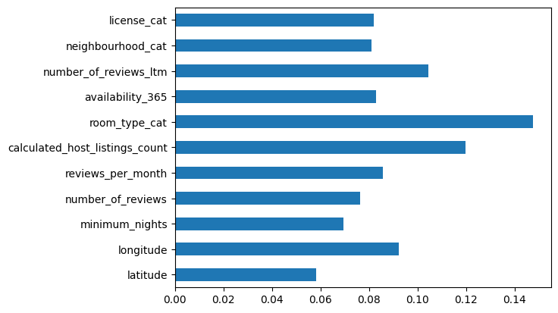
Feature Importance
From the graph it is seen that along with room_type, all other features have importance with categorical price range.
The classification models are trained with all the variables.

Slide 22
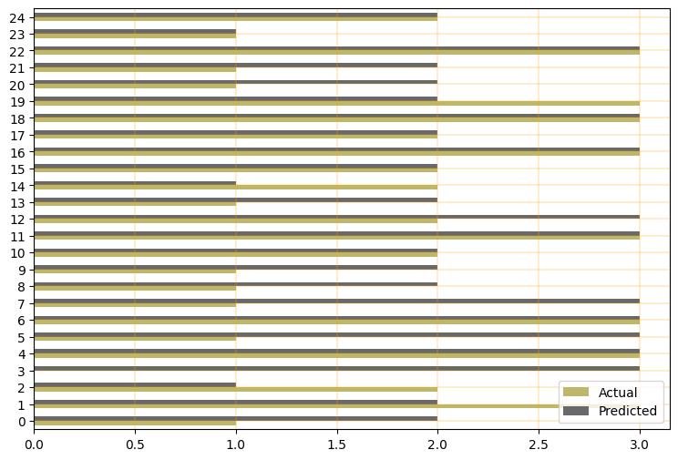
Classification using KNN
KNN predicts the label or value of a new data point by considering its K closest neighbours in the training dataset.

Slide 23
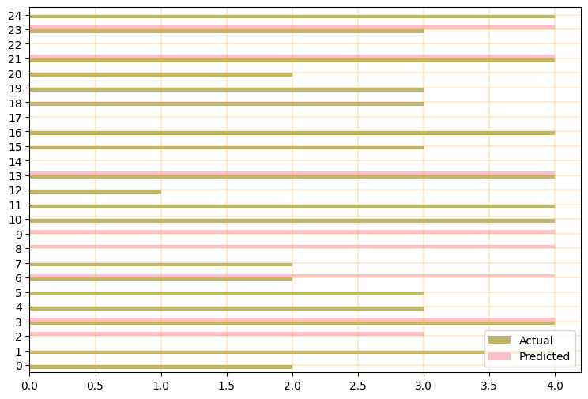
Classification using Support Vector Machines
SVM is supervised learning algorithm. It is used to find the optimal hyperplane in an N-dimensional space that can separate the data points in different classes in the feature space.

Slide 24
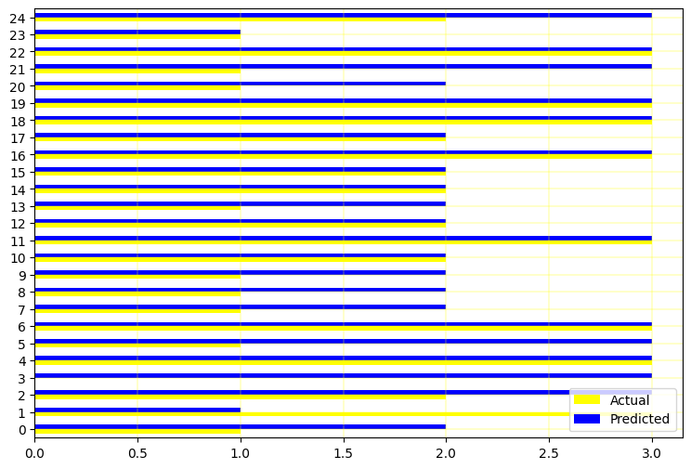
Classification using SVM with Hyperparameter Tuning using GridsearchCV

Slide 25
Classification model comparison & evaluation:
Model | MAE | MSE | RMSE | Score(%)
KNN | 0.8294 | 1.4739 | 1.2141 | 41.2322
SVM | 0.6919 | 1.1563 | 1.0753 | 48.3412
GridsearchCV | 0.6825 | 1.1469 | 1.0709 | 60.2891
SVM model with outliers | 1.7674 | 5.5390 | 2.3536 | 34.7395

Slide 26
Insights :
By predicting the price in range is more efficient that predicting it in continuous variable.
The room_type features explains predictions the most.
Another feature is calculated_host_listings_count, which also contributes more on price prediction.
The data with outliers affects the model accuracy.
By looking at the errors and best score of GridsearchCV model, the MAE is 0.6825 means that the prediction can fluctuate ±0.6825 units. The MSE for this method is 1.0709, means that predicted value can fluctuate ±1.0709 units.

Slide 27
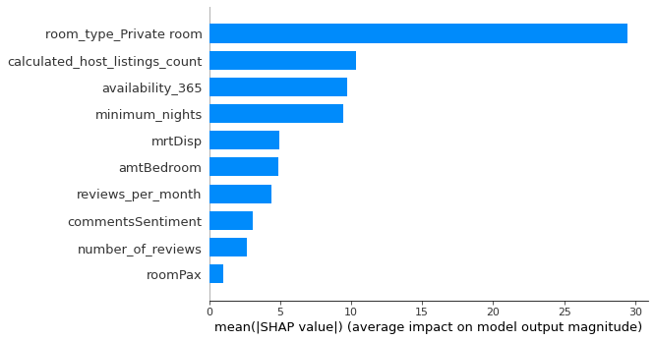
After model evaluation, I get the features that makes the impact on the price prediction:
room_type
calculated_host_listings_count
availability_365
minimum_nights
Recommendation for the Property Owner : keeping the above features in mind, property owner can set their rental prices for their Airbnb listings.

Slide 28
Future Work
Improvement of model accuracy
Deep learning models can be fitted to get more accurate predictions
Transfer learning will be also impactful to get proper insights
User Interface will be designed for the users

